Slide 1
Memory Management Module 5
Operating Systems
Nadia Qureshi

Slide 2
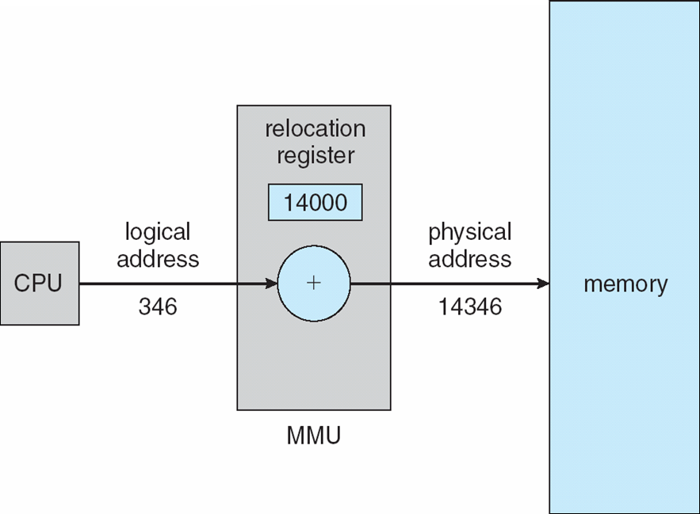
Memory Management Unit

Slide 3
Memory Management Requirements
1. Relocation
Main memory is shared between processes
Swap active processes in and out to provide large pool of ready processes
Quite difficult to declare when swapped out process will be placed back
A process image occupies a contiguous region of main memory
To run this process, the processor hardware and operating system must be able to translate the memory reference found in code, into physical memory address

Slide 4
Memory Management Requirements
2. Protection
Each process must be protected from unwanted interference by other processes
Without prior permission, a process should not refer to other process
All memory references generated by a process must be checked at run time
to ensure that they refer only to the allocated memory space
The processor must abort such instructions when executed
Thus, the memory protection requirement must be satisfied by the processor (hardware) rather than operating system
Since OS cannot anticipate all the memory references a program will make
Even if such participations are possible, it would be prohibitively time consuming to screen each program in advance for possible memory reference violation
MMU

Slide 5
Memory Management Requirements
2. Protection
A pair of base and limit registers define the logical address space
CPU must check every memory access generated in user mode to be sure it is between base and limit for that user

Slide 6
Memory Management Requirements
3. Sharing
Allow several processes to access the same area of main memory
Processes that are cooperating on some tasks may need to share access the same data structure
Allow controlled access to share areas of main memory without compromising essential protection

Slide 7
Memory Management Requirements
4. Local organization
Main memory is organized as a linear or one-dimensional address space that consist of a sequence of bytes or words
Secondary memory at its physical level is similarly organized
It does not correspond to the way programs are constructed
Mostly programs are organized into modules
Some of which are un-modifiable (read or executable only)
Some of which contain that can be modified

Slide 8
Memory Management Requirements
5. Physical organization
Secondary memory of large capacity provides long term storage of program and data
While a smaller main memory holds programs and data currently in use
The organization of flow of information between main memory and secondary memory is a major system concern

Slide 9
Program Loading into Memory
The core task of any memory management system is to bring and manage programs in main memory
In almost all modern multiprogramming systems, this task involves sophisticated scheme known as virtual memory
Virtual memory is in turn based on the use of one or both of two basic techniques
Segmentation
Paging

Slide 10
Memory Management Techniques
Different schemes used in operating systems to allocate memory to processes
Contiguous Memory Allocation
Single process system
Fixed size (static) partition memory
Variable sized (dynamic) partition memory
Non-contiguous Memory Allocation
Paging
Segmentation
Variations of above
Paged segmentation
Demand paging
Demand segmentation
Virtual memory

Slide 11
Contiguous Memory Allocation

Slide 12
Single Process System
Memory is divided into two partitions
One for user process and
One for the operating system
Most common to place the operating system in low memory ( low mean a specific (usually initial) range having bootloaders, interrupt vector and kernel)
Run one process at a time in high memory
Memory management is very simple
Example;
MS-DOS system is an example of this system
Unused
User
process
Operating
system

Slide 13
Fixed Sized Partition Memory
Memory is divided into several fixed partitions
Each partition may contain exactly one process
When partition is free, another process is loaded into free partition
Waste considerable amount of main memory when processes are smaller than allocated partition
Called internal fragmentation
First employed in multiprogramming computers
Used in IBM OS/360
Disadvantages
Prevent a process being run due to unavailability of sufficient size partition
Internal fragmentation wastes space

Slide 14
Fixed Sized Partition Memory
1000 K
Process C
300 K
Partition 3 = 400 K
Partition 2 = 300 K
Partition 1 = 200 K
Low memory containing kernel
600 K
Process B
200 K
300 K
Process A
150 K
100 K
Operating System
0 K

Slide 15
Variable-Sized Partition Memory
The processes would be given as much storage as they required
Processes are loaded into consecutive areas until the memory is filled
When a partition is free, another process is loaded into free partition
External fragmentation
It refers to the distribution of the free memory space, out-with any process allocation
What are the problems here?
What if the size of the vacant partition(s) is smaller than the size of the incoming process?
A new process cannot be started
Solution
Coalescing
It refers to combine two or more adjacent holes to accommodate a large incoming process
Difficulty: Coalescing is a time-consuming procedure

Slide 16
Variable-Sized Partition Memory
Variable partition scheme has been used successfully in many computers
Overheads
In variable partition, the system must keep track of
the position
size of each hole
taking account of the effect of coalescing
The solution is to use linked list, which contains
Pointer to the start of each hole and
The hole size

Slide 17
Variable-Sized Partition Memory
Variable-sized partition with compaction
Compaction is a process of physically moving memory resident processes to close-up the holes
Difficulty;
It is a time-consuming procedure
All processes are suspended while reshuffling takes place
Not feasible in time critical system
Compaction may be performed
As soon as any process terminates
When new process cannot load due to fragmentation
At fixed intervals
When the user decide to do

Slide 18
Storage Management Strategies
Storage management strategies are used to obtain best possible use of main memory
The strategies are divided into following categories
Fetch strategies
Placement strategies
Replacement strategies

Slide 19
Storage Management Strategies
Fetch Strategies
When to obtain the next process for transfer to main memory from secondary memory
It could be done by
Demand fetch strategies
In this next process is brought to main memory when it is referenced by running program
Anticipatory fetch strategies
In this system predicts program’s needs and attempt to load the appropriate process

Slide 20
Storage Management Strategies
Placement Strategies
Placement strategies concerned with determining where in main memory to place an incoming process
Three placement strategies are;
Best fit
Places the process in smallest of the available holes
Intuitively appealing
First fit
Places the process in first available hole, which is large enough to hold it
Low overheads
Worst fit
Places the process in the largest available hole
Another process can be accommodated if hole is big enough
Example;
A variable partition memory with hole sizes in order 20k, 15k, 40k, 60k, 10k, 25k
What if a new process of 25k is to be loaded

Slide 21
Storage Management Strategies
Placement Strategies
Placement strategies concerned with determining where in main memory to place an incoming process
Three placement strategies are;
First fit
Places the process in first available hole, which is large enough to hold it
Search from the start and place in the first available hole
Low overheads
Fast

Slide 22
Storage Management Strategies
Placement Strategies
Placement strategies concerned with determining where in main memory to place an incoming process
Three placement strategies are;
Best fit - (Next fit)
Places the process in smallest of the available holes
Intuitively appealing
Search the entire holes beginning from the start to end in order to find the smallest hole so that after placing the process the remaining hole should be minimum
Searching overhead involved because for every process it searches for best fit hole
It results in mini tiny little holes where no process can be placed
Slow

Slide 23
Storage Management Strategies
Placement Strategies
Placement strategies concerned with determining where in main memory to place an incoming process
Three placement strategies are;
Next fit ( extension of first fit)
Places the process in the next available hole which is big enough to accommodate the process
A pointer is placed to start searching from the previously allocated hole location
Search the next available hole beginning from the last location to find the next hole capable of accommodating the process.
fast

Slide 24
Storage Management Strategies
Placement Strategies
Placement strategies concerned with determining where in main memory to place an incoming process
Three placement strategies are;
Worst fit
Places the process in the largest available hole
Another process can be accommodated if hole is big enough
Search from the beginning till end in order to find the largest hole in order to place the process.
Slow
Example;
A variable partition memory with hole sizes in order 20k, 15k, 40k, 60k, 10k, 25k
What if a new process of 25k is to be loaded

Slide 25

Example P1= 15K P2 = 18K
25K
40K
100K
20K
10K

Slide 26

Practice Problem: Respectively P1= 300K P2 = 25K P3=125K P4=50K Best Fit? First Fit? Both? None?
150K
350K

Slide 27
Storage Management Strategies
Replacement Strategies
They are concerned with determining which process to displace to make room for incoming process
Decision is made on different factors

Slide 28
Non-contiguous Memory Allocation
Paging & Segmentation

